Slide 1
QAT Scan
Business drivers
QAT Scan provides a narrative findings document and summary presentation to show owners their current state, what fixes should be addressed and a path forward leveraging the propositions based on the QAT Scan findings.
Offering overview
The QAT Scan analyzes the health of a Pega application to address how to enhance and leverage features in modern Pega versions that were unavailable or not implemented during initial installation. The report would lead the transformation by establishing fact-based findings of the current state to propose using a newer version to leverage the latest features for new business outcomes.
Offering benefits
QAT Scan provides an assessment of older versions of currently installed Pega applications and presents an assessment of the current application, the critical findings and the areas that could benefit from features in a later version. It is a direct benefit for clients with outdated Pega installations. Modern Pega features could bring business value to the already-installed application.
Assessing the path to application modernization
Pega impact | EY impact
QAT Scan helps clients upgrade their systems, utilize out-of-the- box Pega features and better justify their initial purchase of Pega licensing. Clients’ confidence in Pega and future Pega purchases will improve through QAT Scan. | Not every organization can run an assessment like QAT Scan. By offering this service, we are establishing ourselves as Pega implementation and technology pros. With QAT Scan, we can deduce complex and insightful recommendations for improvement by looking at tool-identified problem areas.
Products leveraged
Only Pega platform is required

Slide 2
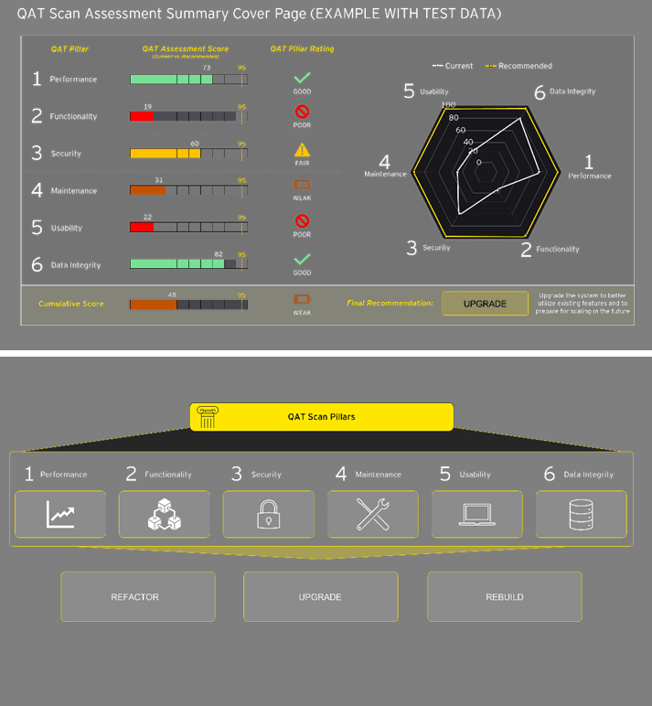
Offering differentiators
QAT Scan delivers a raw result of the automated analysis and a final assessment recommendation, defined by Pega subject-matter resources through insightful review. Far-reaching implications for our clients’ tech platforms, operations and strategy. Every QAT Scan recommendation will tie back to a known business KPI or metric.
Customer profile
Sectors: All Roles: CXO, SVP that owns the applications running on Pega, or the business owners who leverage Pega applications. The key target is legacy Pega applications that are not leveraging key product capabilities. Fields of play: IT-transformation
Developing an opportunity
Interest-generating questions | Sales approach | Cross-selling and upselling
What was your vision when you first began your transformation, and do you feel like you have achieved it? Have you seen the latest industry features and widgets that could be useful, but don’t know if they are compatible or possible with your system? How can you ensure that your platform is aligned with the Pega’s latest features, competitively designed, and scalable and adaptable for change? | QAT Scan is a relatively inexpensive way of getting our foot in the door with new clients. We can build relationships with these clients by establishing our EY-Pega credibility with minimal client investment — all with the vision that they will want to work with EY teams for the various recommendations we supply them as a QAT Scan deliverable. | QAT Scan enables us to also sell the delivery services for the recommended changes, broader enterprise architecture strategy, cloud migration services and more.
Contacts
EY and Pega: accelerate transformation with confidence
Significant challenges. Big ambitions. There’s a lot on the line for business in a world that’s ever-changing. It takes both powerful technology and sophisticated business insights to realize success, shape legacies and innovate for the future.
The EY organization and Pega lead with an outcomes-first approach to elevate their clients’ businesses to be more productive, more agile, and better prepared to thrive in the fast-paced Transformative Age.
By combining EY strategic thought leadership capabilities with Pega’s focus on simplifying business complexity, the EY-Pega Alliance is helping clients make smarter decisions, deliver richer experiences and accelerate time to value.
Together, the EY-Pega Alliance helps you simplify business complexity so you can innovate faster, drive transformative outcomes and deliver experiences people love.
For more information, visit: ey.com/pega
EY US
Jamie Campbell
Senior Manager, DET
Ernst & Young LLP
Phone: +1 407 428 6894
jamie.h.campbell@ey.com
Pega
Suzanne Clayton
Global Partner Director
Pega Corporation
suzanne.clayton@pega.com

Slide 3
EY | Building a better working world
EY exists to build a better working world, helping to create long-term value for clients, people and society and build trust in the capital markets.
Enabled by data and technology, diverse EY teams in over 150 countries provide trust through assurance and help clients grow, transform and operate.
Working across assurance, consulting, law, strategy, tax and transactions, EY teams ask better questions to find new answers for the complex issues facing our world today.
EY refers to the global organization, and may refer to one or more, of the member firms of Ernst & Young Global Limited, each of which is a separate legal entity. Ernst & Young Global Limited, a UK company limited by guarantee, does not provide services to clients. Information about how EY collects and uses personal data and a description of the rights individuals have under data protection legislation are available via ey.com/privacy. EY member firms do not practice law where prohibited by local laws. For more information about our organization, please visit ey.com.
Ernst & Young LLP is a client-serving member firm of Ernst & Young Global Limited operating in the US.
© 2023 EYGM Limited. All Rights Reserved.
EYG no. 005043-23Gbl ED None
This material has been prepared for general informational purposes only and is not intended to be relied upon as accounting, tax, legal or other professional advice. Please refer to your advisors for specific advice.
ey.com

